Slide 1


SWE 342
TECHNICAL WRITING AND PRESENTATION
SEMESTER: 3/2, SOFTWARE ENGINEERING, SUST

Slide 2




Presented By:
PROMI MOJUMDER
REG NO: 2019831038
SUMONTA SAHA MRIDUL
REG NO: 2019831056

Slide 3

CONTENT
01
TITLE AND INTRODUCTION
02
AUTHORS AND AFFILIATION
03
OBJECTIVE
04
DATASET AND DATABASE
05
METHODOLOGY
06
ACCURACY AND LIMITATION
07
TECHNOLOGIES
08
APPLICATIONS

Slide 4
TITLE AND INTRODUCTION
“An Effective Method for the Recognition and Verification of Bangladeshi Vehicle Digital Number Plates”

Slide 5

AUTHORS AND AFFILIATION
AUTHORS
Md. Ashraful Islam and Ahsan Habib
Institute of Information and Communication Technology, Shahjalal University of Science and Technology, Sylhet, Bangladesh
AFFILIATION

Slide 6
OBJECTIVE
In this study, an effective and automatic technique has been proposed to detect, recognize and verify Bangladeshi number plates

Slide 7


DATASET AND DATABASE
Developed a dataset of 500 Bangladeshi number plate images for research
Created a template dataset and cloud database for character recognition and vehicle verification

Slide 8
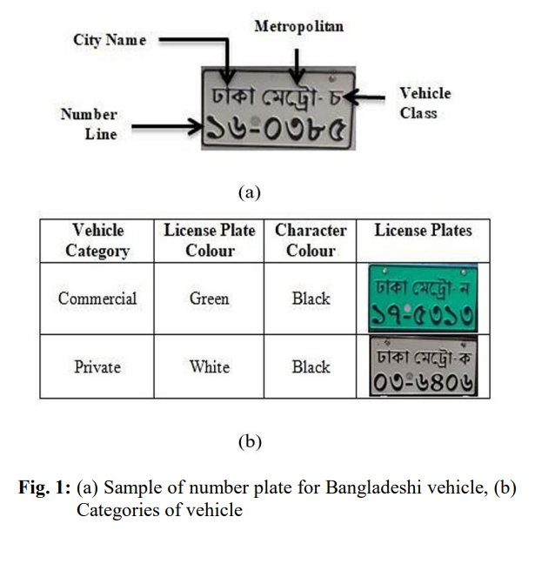
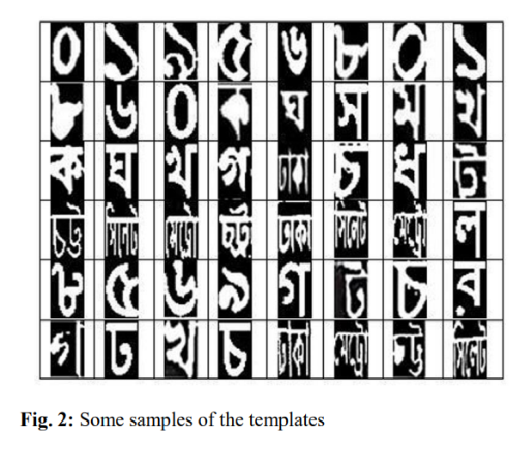

Slide 9
METHODOLOGY

Slide 10
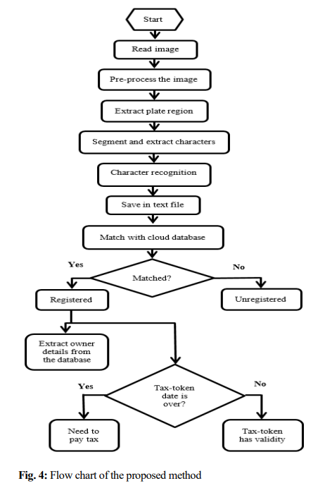
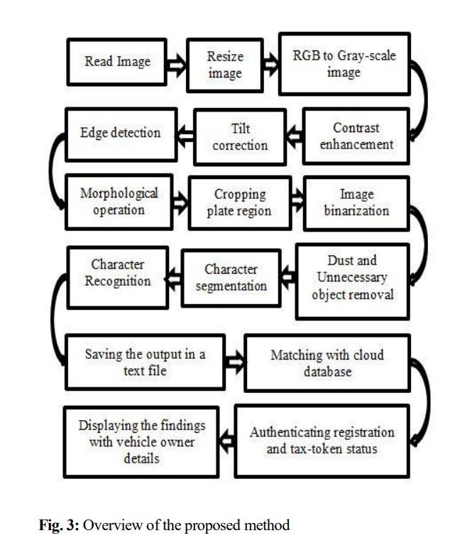

Slide 11
METHODOLOGY
The input image is resized and converted to grayscale before undergoing contrast enhancement and tilt correction
IMAGE PROCESSING
EXTRACTION AND SEGMENTATION
Edge detection, morphological operations, bounding box method, and character segmentation

Slide 12
METHODOLOGY
Template matching technique for recognizing Bangla characters and the results are stored in a text file
CHARACTER RECOGNITION
VEHICLE VERIFICATION
The text file is compared with a cloud database containing registered vehicle details. If a match is found in the database, the vehicle is marked as registered, and the system extracts owner details and checks the validity of the car's tax-token

Slide 13
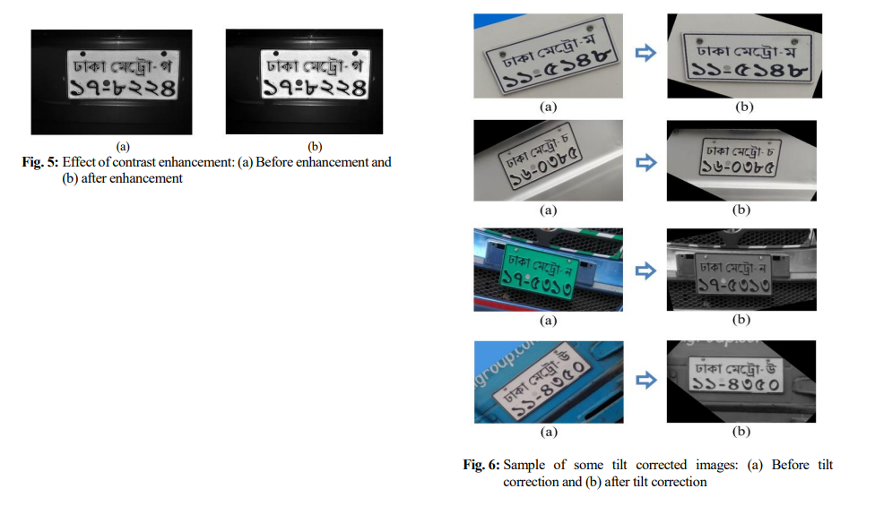
IMAGE PROCESSING

Slide 14
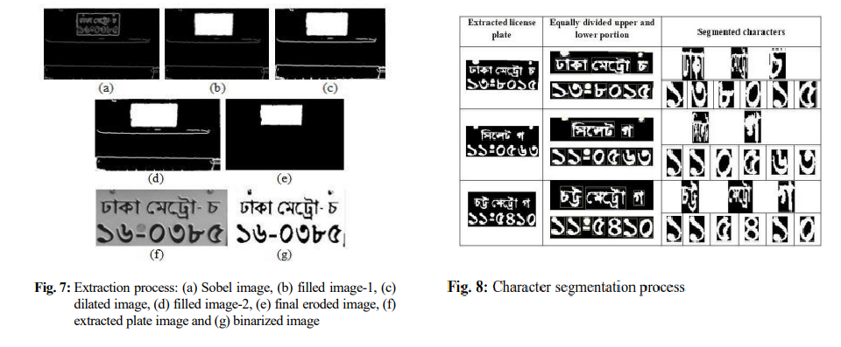
EXTRACTION AND SEGMENTATION

Slide 15
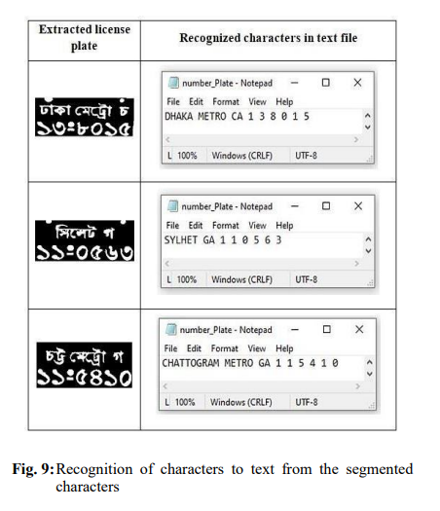
CHARACTER RECOGNITION

Slide 16
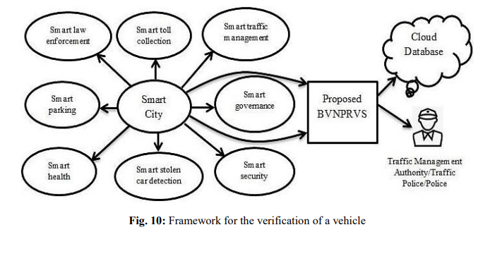
VEHICLE VERIFICATION

Slide 17
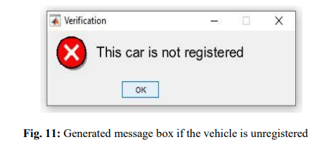
VEHICLE VERIFICATION

Slide 18
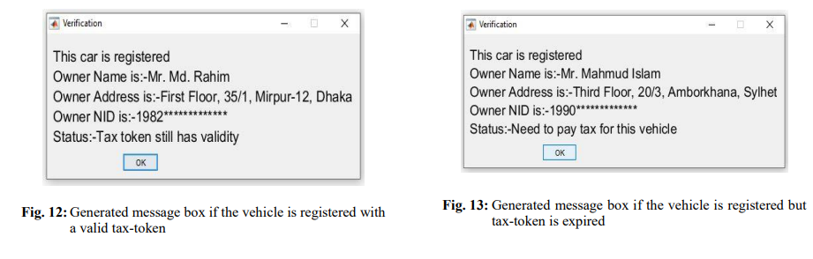
VEHICLE VERIFICATION

Slide 19


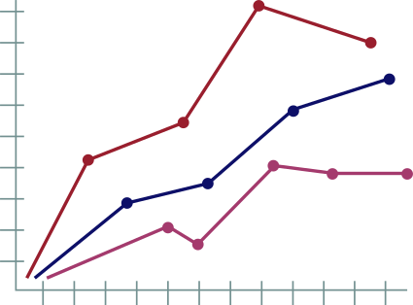
ACHIEVED ACCURACY
Plate Detection: 96.8% (484 out of 500 plates detected)
Plate Extraction: 94.8% (459 out of 484 detected plates extracted)
Character Segmentation: 98.3% (451 out of 459 extracted plates segmented)

Slide 20
ACHIEVED ACCURACY
Character Recognition: 97.6% (440 out of 451 segmented plates recognized)
Word Recognition: 98.3%
Letter Recognition: 98.4%
Digit Recognition: 98%

Slide 21
OVERALL ACCURACY
Detection Accuracy: 96.8%
Extraction Accuracy: 94.8%
Segmentation Accuracy: 98.3%
Recognition Accuracy: 97.6%

Slide 22
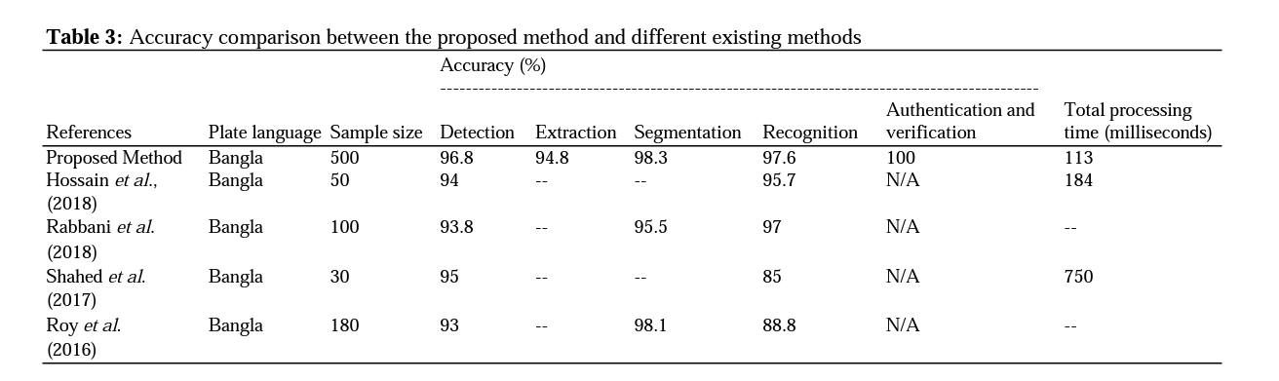
ACCURACY COMPARISON WITH EXISTING METHODS

Slide 23
LIMITATIONS
TILT ANGLE HANDLING
The system can correct tilts of up to 45 degrees; beyond that, it cannot process the image
The system may fail when the input image is too blurry, features excessive noise in the background, has very low resolution, or if the number plate is damaged.
IMAGE QUALITY

Slide 24
RESULT SUMMARY
The proposed system operates efficiently, providing fast verification by directly searching the cloud database, resulting in a shorter processing time compared to alternative methods
EFFICIENCY
When compared to other existing methods, the proposed approach stands out due to its significantly higher sample size, superior accuracy, and unique ability to authenticate and verify number plates
COMPARISON WITH EXISTING METHODS

Slide 25

TECHNOLOGIES
The research was conducted using MATLAB 2019a in an environment comprising a 64-bit Windows 10 Pro operating system, Intel Core i7 CPU, 1TB hard disk, 500 GB SSD, and 8 GB RAM. A Gigabyte RX 6900 XT GPU with 16 GB RAM was used for faster processing

Slide 26
APPLICATIONS
This research creates a valuable dataset of Bangla templates, aiding researchers in automating Bangladeshi car number plate detection, recognition, and verification
RESEARCH SUPPORT
Offers the Bangladesh Road Transport Authority (BRTA) the capability to automatically identify unregistered vehicles or those with expired tax tokens using their cloud database, facilitating the collection of registration fees and taxes
REVENUE COLLECTION

Slide 27
APPLICATIONS
Assists traffic authorities in identifying stolen or suspicious vehicles by simplifying the comparison of extracted data with BRTA's cloud database of reported number plate details
ENHANCED SECURITY
VERSATILE APPLICATIONS
The system's utility extends to various applications, including automatic car parking management, toll collection, and law enforcement by the Bangladesh police.

Slide 28
Thank You

